Slide 1
Natural Scenes Image Classification Project
Andrew Tiu, Kelly Wu, Sherry (Yixuan) Wu

Slide 2
Background
kNN
Training images
Classify natural scenes images
PCA
Data frames
Random Forests
Testing
images
SVM
Notes:
· Belong to the field of computer vision - image classification
· Widely used in many fields - agriculture, e-commerce and so on
· interested in seeing how simpler supervised and unsupervised machine learning techniques such as k-nearest neighbors, random forest, and support vector machines perform in an image classification setting.

Slide 3
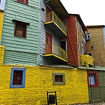
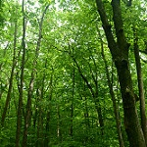
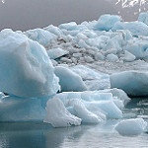
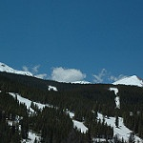
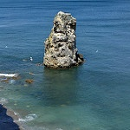
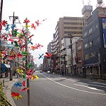
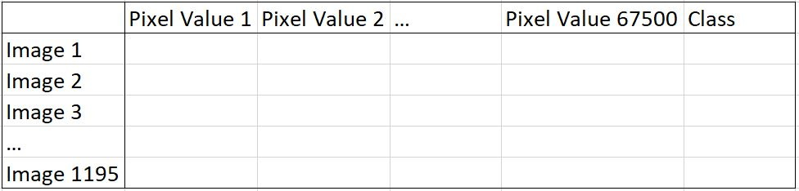
Data Overview
Building
Forest
Glacier
Mountain
Sea
Street
Notes:
· The amount of images are slightly over 2000 within each category.
· Since the standard size of each image is 150 x 150, we were able to convert each of these images to a vector of length 67501 (150 x 150 + 1 for corresponding class label).
· Eliminate bad image

Slide 4
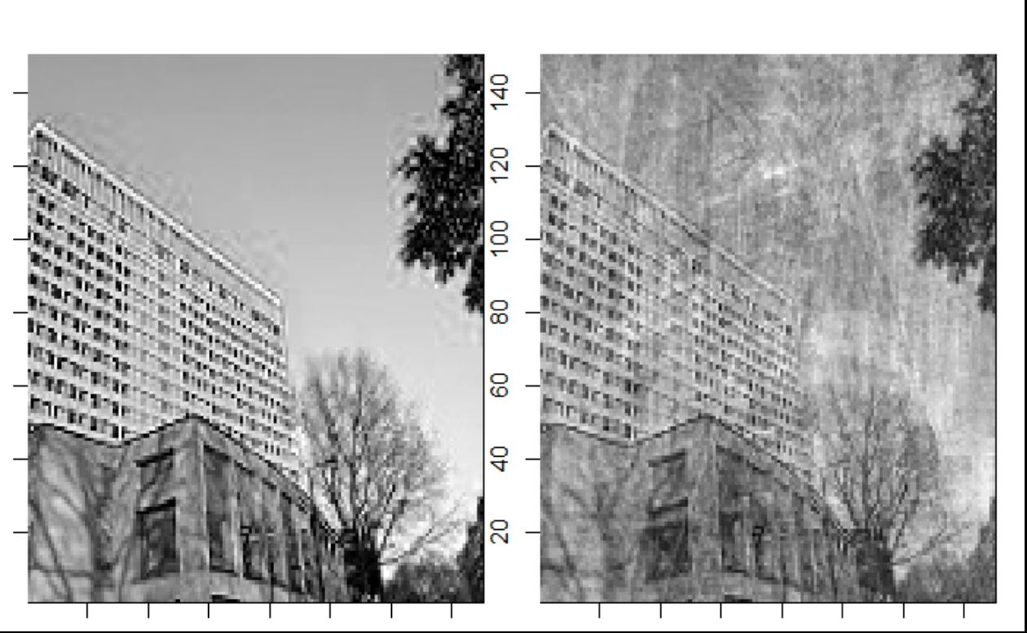
Data Processing - PCA
Conduct on training image set
99 PCs - 75%
170 PCs - 80%
442 PCs - 90%
Extract 99 PCs, which account for 75% variability of the data
Projected results onto test set of image

Slide 5
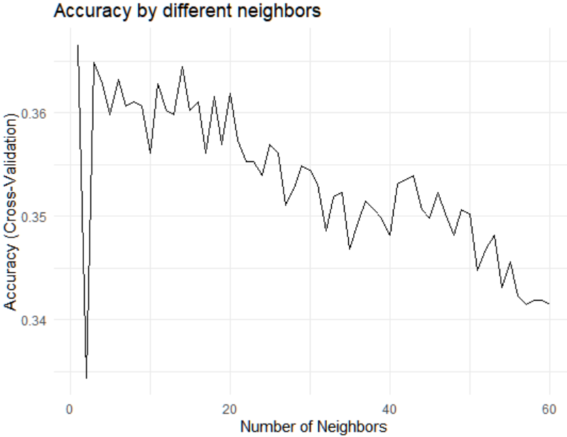
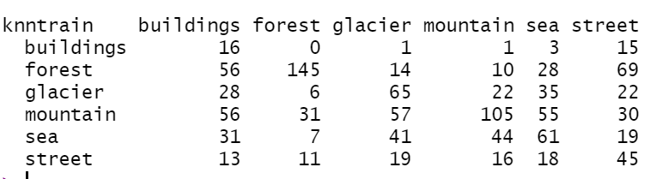
Classification - kNN
Accuracy = sum of diagonals / overall sum = 36.56%
Notes:
The first supervised learning method examined here is k-nearest neighbors (kNN) on both the training and test set. All the principal components are min-max normalized so that all variables, regardless of their variability, are weighted equally in our decision. After scaling, the variables range between 0 and 1. Next, the optimal number of k is determined using 10-fold cross-validation. A plot of cross-validated accuracies across different neighbors is shown in Figure 1. 1 neighbor provides the highest accuracy. From the confusion matrix, accuracy is calculated to be 36.56%, with the misclassification error as 63.43%. The resulting confusion matrix is shown in Table 1.

Slide 6
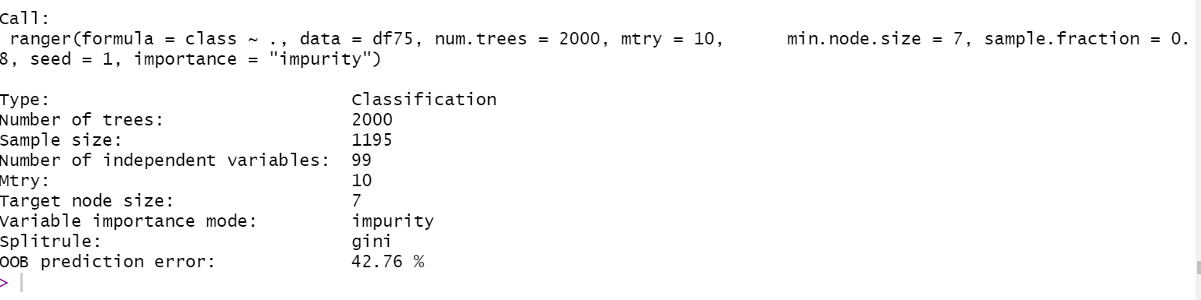
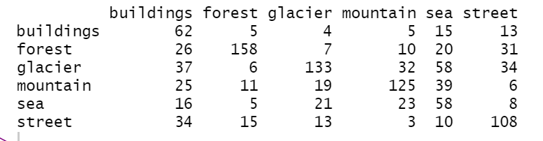
Classification - Random Forest
Accuracy = sum of diagonals / overall sum =53.89%

Slide 7
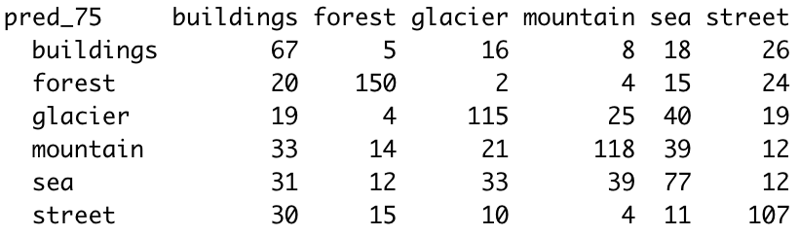
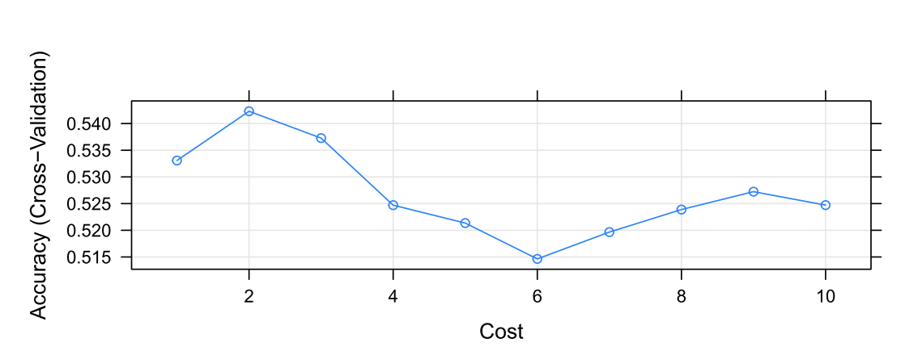
Classification - SVM
Accuracy = sum of diagonals / overall sum = 53.05%

Slide 8
Performance comparison
 | Accuracy Level
kNN | 37%
Random Forests | 54%
SVM | 53%
Total observations in training set: 1197
Total observations in test set: 1195
Notes:
One prominent observation across the three methods is that the classification of sea and building images is not as accurate as the other four classes.

Slide 9
Conclusion
Our methods have constraints in terms of image classification
Acknowledge the bias in the data and data pre-labeling done by humans
Computational time limits and local storage capacities
Explore more advanced feature selection and dimensionality reduction techniques besides PCA

